Slide 1
Sacramento Real Estate: Finding Average
Shawn Cavazos, Edward Michaud, Amara Hamadache
5/08/2021

Slide 2

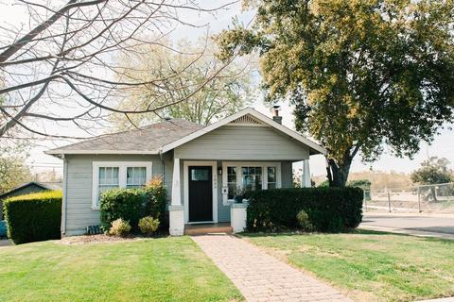
The Scenario:

Slide 3
How do we satisfy the request?
Locate and clean the Data
Create bins of data to represent common breakpoints
Create visual aides to guide our home buyer
Identify current trends in the market
What are the common metrics for the average home purchase

Slide 4
Other Considerations
Identify/Eliminate outliers
Using median or mean?
Which charts are most helpful visual aides

Slide 5
Overall Game plan
First, Locate and clean the data
Next, we analyze the data and create practical depictions
Finally, a conclusion is drawn from all the data we created throughout this project with the assistance of the graphs that have been created to present to the client as the most average property.

Slide 6
Initial setup:
Various dependencies were added such as matplot, pandas, pprint, numpy, seaborn, scipy, and csv.
Next, the csv file was added to the script. It was then tested to be read in the script.
Then, it was cleaned up, there would be no repetitive locations or places that were given a value of zero in square foot.

Slide 7
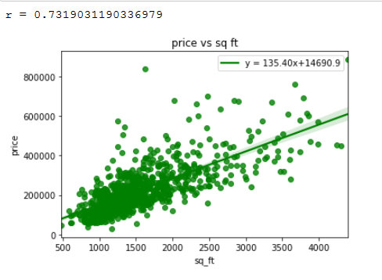
Making the Scatter plot graph:
A graph from square foot to its price was first created.
This shows how more people would settle around the 1000-2000 square foot mark and pay around $200,000-$300,000 range.
It becomes less popular to buy housing that is around $400,000 - $600,000 range when the square foot amount increases.
Our client is willing to purchase a house that is about $207,000 and is about 1500 Square feet after viewing the data.

Slide 8
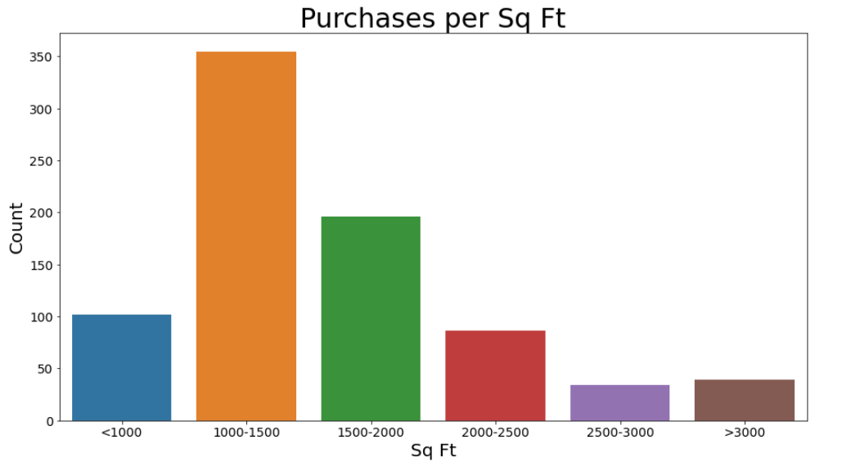
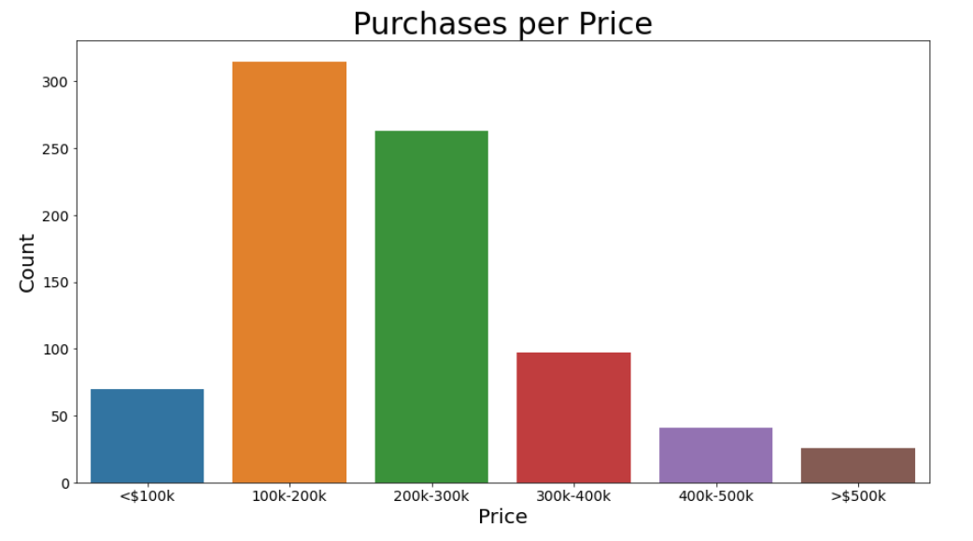
Making a bar graph
A bar graph was used to depict the occurrences of purchase of houses and their price range.
Information about how many purchases were made Per square foot.
Information about purchases per zip code was also presented.
A bar graph for purchases per day was then created.
Another bar graph was made for bedroom count.
The client was willing to buy a house with 3 Bedrooms

Slide 9
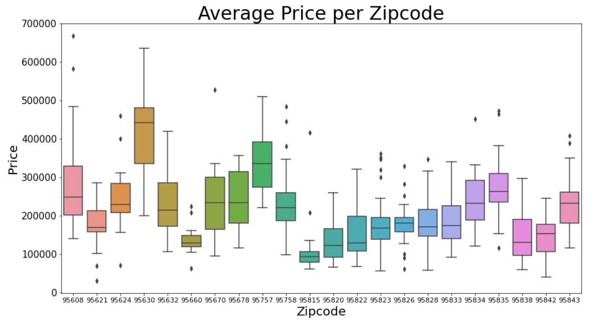
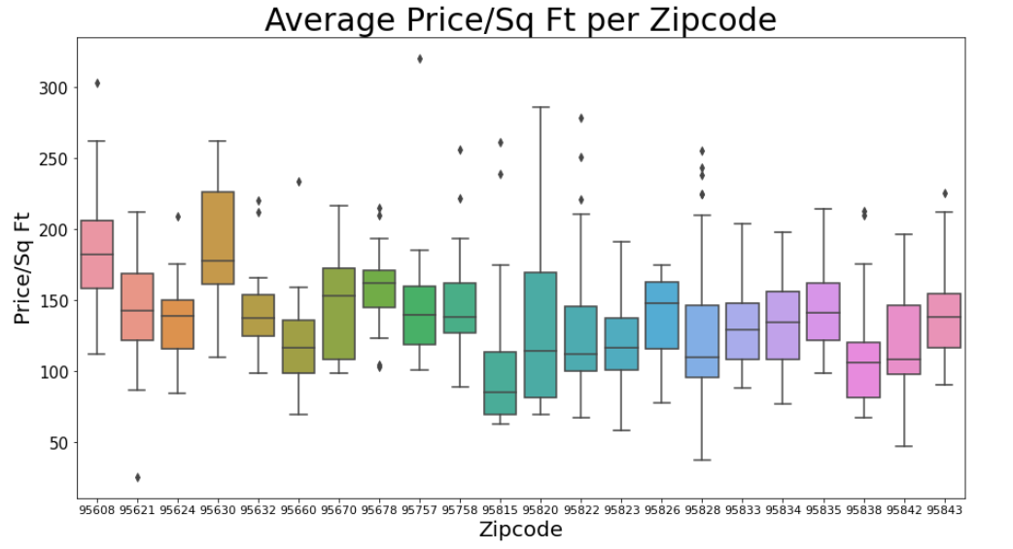
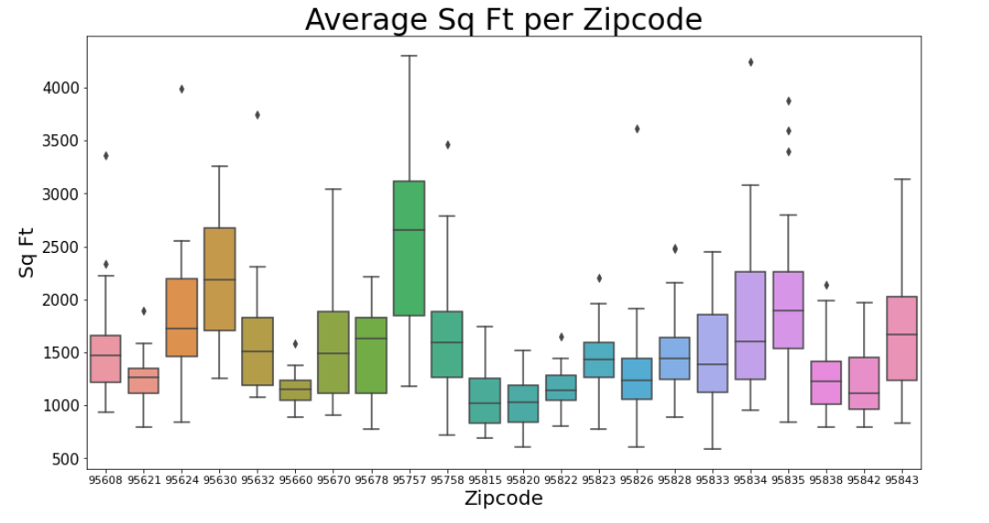
Making a box graph
A box graph made with whiskers was used to find variation between zip codes.
Boxes represented the mean and the lines are the highest/lowest outliers.
One was made for average price, another for average square foot, and average price per sqr foot.
The client was interested in living in the area with zip code 95823.

Slide 10
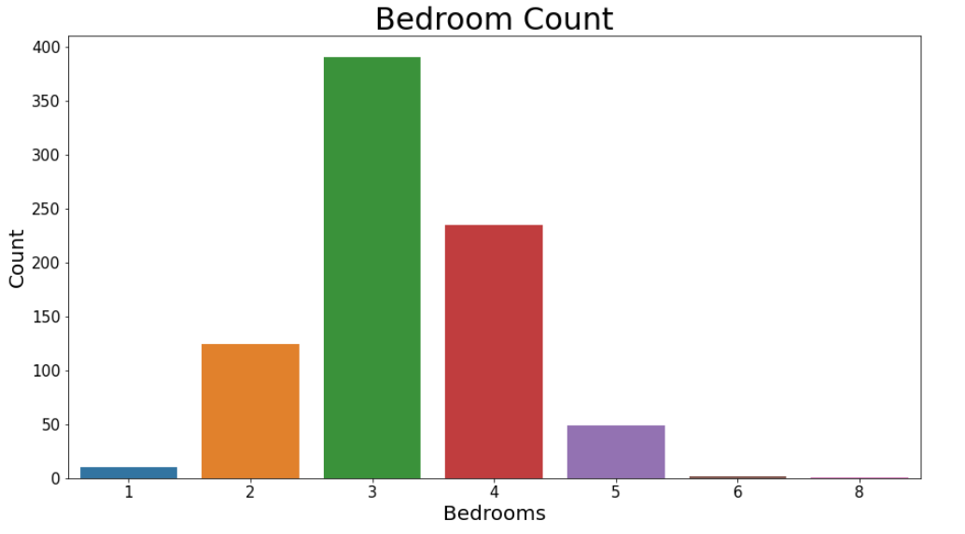
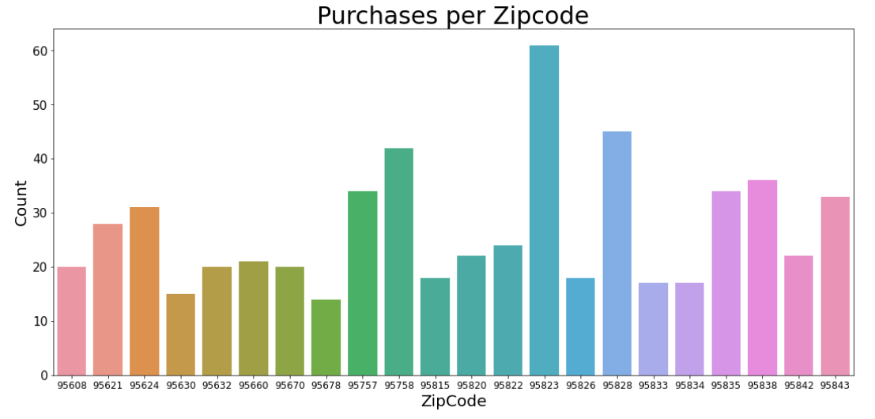

Slide 11
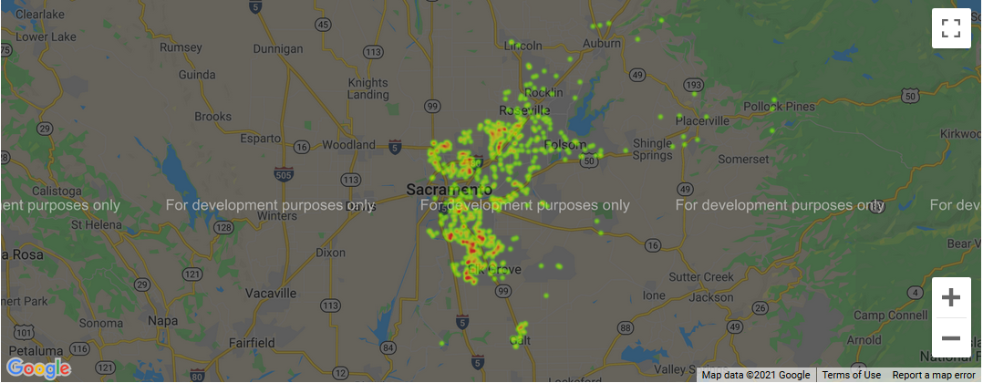

Slide 12
Making the Heat Map
A map of where clusters of purchases was then created.
There is also another based on zip codes too.
This shows where in Sacramento are most of the purchases were being made.
Our client’s decision was made to buy a house in the southeast part of the city, where it’s mostly populated.

Slide 13

Conclusion:
Our client is interested at purchasing a house at around $207,000 Dollars, about 1500 Square feet, has 3 bedrooms, and lives in the southeast part of Sacramento with a zip code of 95823.

Slide 14
Questions?
#About coding (like what is seaborn) Data visual library based on matplotlib.
#Why Sacramento? It was selected because it had enough data that is very comprehensible and lengthy enough for a proper project, but not too large to become cumbersome and make our graphs look messy.
#What was interesting about this Data? Trends

